Slide 1



Nano-Copper Inhibition of
Anaerobic Digestion in Wastewater Treatment
Sara J Gallagher, Jorge Gonzalez-Estrella,
Jim Field, and Reyes Sierra-Alvarez
22nd Annual AZ Space Grant Consortium Symposium
April 12th, 2014

Slide 2
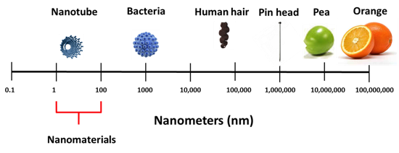
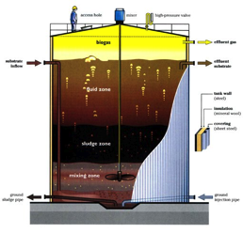

What Are Nano-Particles?
Nano-particles (NPs)
Discharged in sewage pipelines to wastewater treatment plants
Cu⁰ NPs INHIBIT methane-producing microorganisms (methanogens).
Image source: http://www.hermione-presents.com/back_home/back_home%20tours.htm

Slide 3

Why Are Nano-Particles Important?
Nano-particles (NPs) are currently used in large quantities in many common consumer products, including toiletries and personal-care items.
Research has indicated that some types of NPs have toxic effects on human health and the environment.
Image source: http://www.westcoastcosmetics.com/

Slide 4
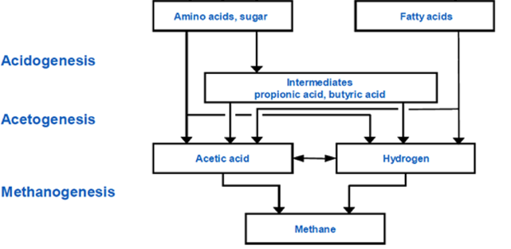
The Biochemistry
Start Here
OR Start Here
End
Image source: www.wtert.eu

Slide 5
Objectives
To determine how the addition of Cu⁰ NPs affects:
The consumption of glucose/propionate and
The production of methane (CH₄) by
microorganisms involved in anaerobic digestion.

Slide 6
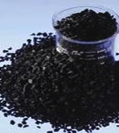
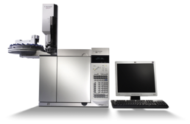

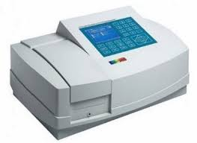
Procedure
Dispersion of NPs
Anaerobic granular sludge
GC-TCD
Different concentrations
N₂/CO₂
Overnight incubation
Propionate and CH₄
T (35°C), 115 rpm
Electron donor: glucose or propionate
Glucose

Slide 7
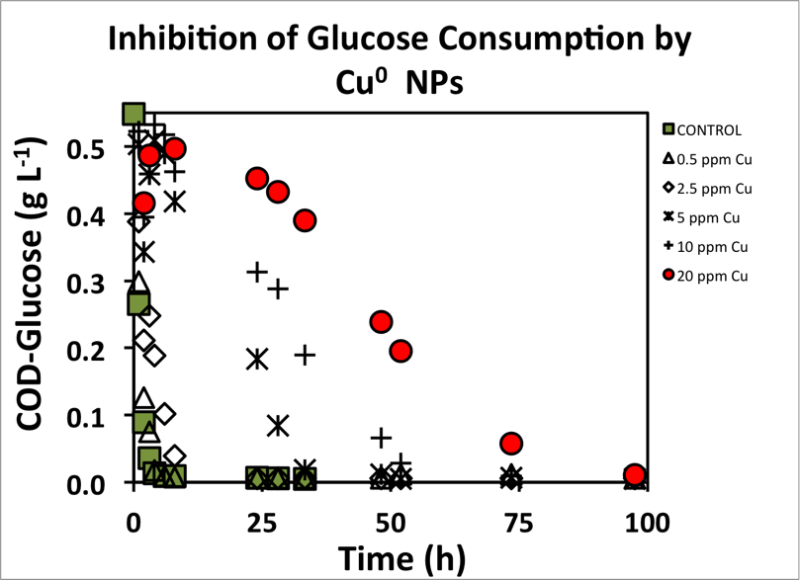
IC₅₀ = 7 ppm
20 ppm Cu⁰ NP decreased the maximum consumption glucose rate
by 3x.

Slide 8
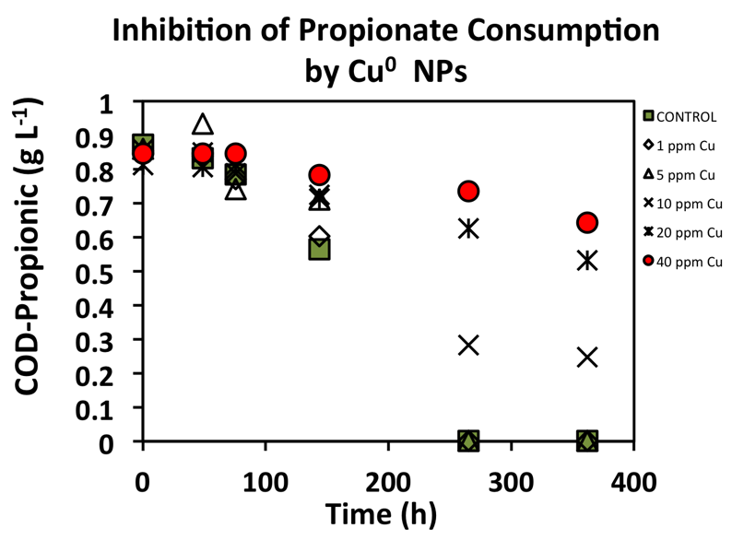
IC₅₀ = 15 ppm
20 and 40 ppm Cu⁰ NP decreased the maximum propionate consumption rate by 3x and 4x respectively.

Slide 9
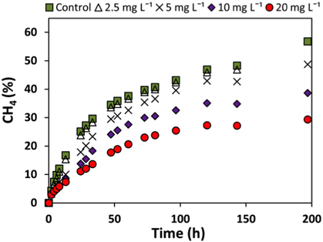
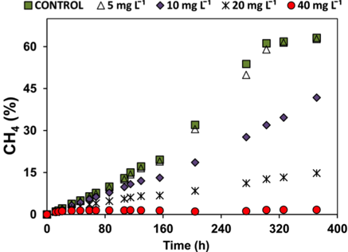
Inhibition of Methanogenesis in Assays Supplied with Glucose and Propionate
IC₅₀ = 20 mg L⁻¹ Cu⁰ NPs
(substrate: glucose)
IC₅₀ = 10 mg L⁻¹ Cu⁰ NPs
(substrate: propionate)
Methanogenesis was more inhibited by nano-Cu in assays
using propionate as a substrate.

Slide 10
Conclusions
    Cu⁰ NP are toxic to various anaerobic microbial populations including methanogens as well as glucose- and propionate-degrading microorganisms.
    Low concentrations of nano-Cu (≥ 5 ppm) can cause serious inhibition of anaerobic digestion processes.

Slide 11
Acknowledgments
Mentoring and lab access: Dr. Reyes Sierra and
Dr. Jim Field
PhD candidate: Jorge Gonzalez-Estrella
Facilities: The University of Arizona
Program: Arizona NASA Space Grant Consortium

